Slide 1

Strictness And Laziness
Ankit Bahuguna (Ankit.Bahuguna@Teradata.com)
{11.09.2014}

Slide 2
What we will cover today?
Strict and Non-Strict (Lazy)Functions.
How laziness can be used to improve the efficiency and modularity of functional programs?
Lazy List / Streams
Memoisation Streams and Avoiding Re-Computation
Helper Functions for Inspecting Streams.
Separating Program Description from Evaluation.
Infinite Streams and Corecursion
Conclusion

Slide 3
Let’s Start with a Program Trace for List
List(1,2,3,4).map(_ + 10).filter(_ % 2 == 0).map(_ * 3)
List(11,12,13,14).filter(_ % 2 == 0).map(_ * 3)
List(12,14).map(_ * 3)
List(36,42)
This view makes it clear how the calls to map and filter each perform their own
traversal of the input and allocate lists for the output.

Slide 4
The catch?
Wouldn’t it be nice if we could somehow fuse sequences of transformations like this into a single pass and avoid creating temporary data structures?

Slide 5
And….
It turns out that we can accomplish this kind of automatic loop fusion through the use of non-strictness (or, less formally, laziness).
☺

Slide 6
First: Let’s Cover some Basics.
Non-strictness (function) means that the function may choose not to evaluate one or more of its arguments.
A strict function always evaluates its arguments. (sort of norm!)
Most languages only support functions that expect their arguments fully evaluated.
Unless we tell it otherwise, any function definition in Scala will be strict.

Slide 7
Example : Strict Function
def square(x: Double): Double = x * x
If we invoke:
square(41.0 + 1.0) = 42.0*42.0 [STRICT]
square(sys.error("failure")) = Exception!

Slide 8
But, We are already familiar with Non-Strictness!
The function && takes two Boolean arguments, but only evaluates the second argument if the first is true:
scala> false && { println("!!"); true } // does not print anything
res0: Boolean = false
And || only evaluates its second argument if the first is false:
scala> true || { println("!!"); false } // doesn't print anything either
res1: Boolean = true

Slide 9
+Example: non-strictness
val result = if (input.isEmpty) sys.error("empty input") else input
This ‘if’ function would be non-strict, since it won’t evaluate all of its arguments.
In Scala, we can write non-strict functions by accepting some of our arguments unevaluated.

Slide 10
The Scala, if2[A]: Enters “thunk”
def if2[A](cond: Boolean, onTrue: () => A, onFalse: () => A): A =
if (cond) onTrue() else onFalse()
if2(a < 22,
() => println("a"),
() => println("b")
)
The arguments we’d like to pass unevaluated have a () => immediately before their type.
A value of type () => A is a function that accepts zero arguments and returns an A.
The unevaluated form of an expression is called a thunk, and we can force the thunk to evaluate the expression and get a result. We do so by invoking the function, passing an empty argument list, as in onTrue() or onFalse().

Slide 11
Cleaner Syntax
def if2[A](cond: Boolean, onTrue: => A, onFalse: => A): A =
if (cond) onTrue else onFalse
scala> if2(false, sys.error("fail"), 3)
res2: Int = 3
With either syntax, an argument that’s passed unevaluated to a function will be evaluated once for each place it’s referenced in the body of the function.
Scala won’t cache the result of evaluating an argument!

Slide 12
Why Caching? : Example
scala> def maybeTwice(b: Boolean, i: => Int) = if (b) i+i else 0
maybeTwice: (b: Boolean, i: => Int)Int
scala> val x = maybeTwice(true, { println("hi"); 1+41 })
hi
hi
x: Int = 84
What’s going on here?: i is referenced twice in the body of maybeTwice, and we’ve made it particularly obvious that it’s evaluated each time by passing the block {println("hi"); 1+41}, which prints hi as a side effect before returning a result of 42. The expression 1+41 will be computed twice as well.

Slide 13
Caching the Value: Using lazy keyword!
scala> def maybeTwice2(b: Boolean, i: => Int) = {
| lazy val j = i
| if (b) j+j else 0
| }
maybeTwice: (b: Boolean, i: => Int)Int
scala> val x = maybeTwice2(true, { println("hi"); 1+41 })
hi
x: Int = 84
Adding the lazy keyword to a val declaration will cause Scala to delay evaluation of the right-hand side of that lazy val declaration until it’s first referenced. It will also cache the result so that subsequent references to it don’t trigger repeated evaluation.

Slide 14
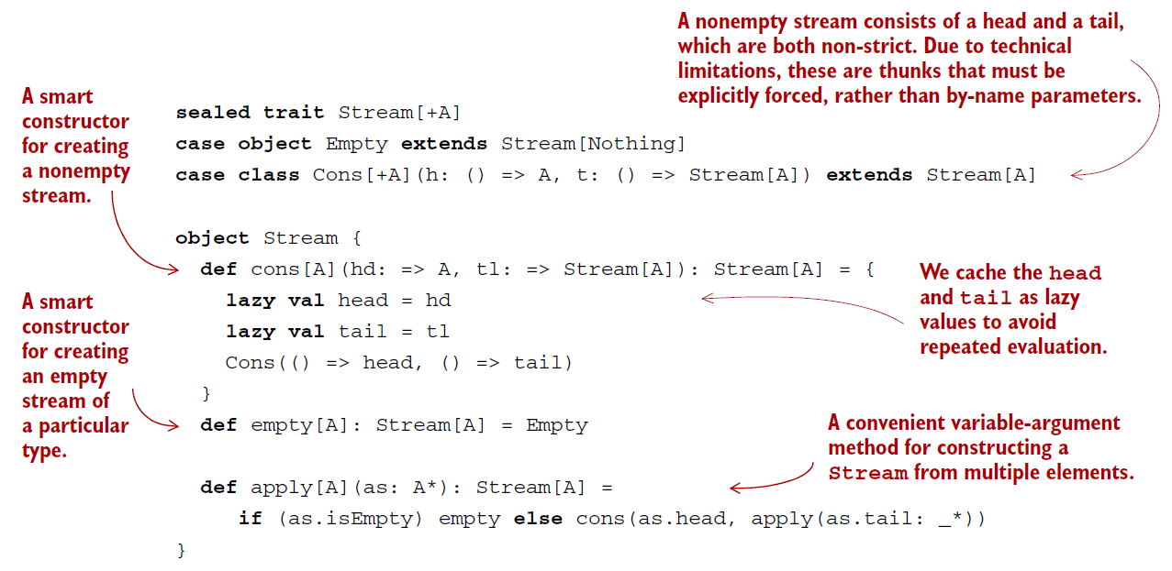
Lazy Lists / Streams
Notes:
This type looks identical to our List type, except that the Cons data constructor takes
explicit thunks (() => A and () => Stream[A]) instead of regular strict values. If we wish
to examine or traverse the Stream, we need to force these thunks as we did earlier in
our definition of if2.

Slide 15
EXAMPLE: Function to optionally extract the head of a Stream
def headOption: Option[A] = this match { case Empty => None case Cons(h, t) => Some(h()) //Explicit forcing of the 'h' //thunk using h() } Note: We have to force h explicitly via h() , but other than that, the code works the same way as it would for List . But this ability of Stream to evaluate only the portion actually demanded (We don’t evaluate the tail of the Cons) is useful!

Slide 16
Memoizing Streams and Avoiding Recomputation
We typically want to cache the values of a Cons node, once they are forced. If we use the Cons data constructor directly, For instance, this code will actually compute expensive(x) twice:
val x = Cons(() => expensive(x), tl)
val h1 = x.headOption
val h2 = x.headOption
How to Avoid this? We define smart constructors i.e. function for constructing a data type that ensures some additional invariant or provides a slightly different signature than the “real” constructors used for pattern matching.
Convention, smart constructors typically lowercase the first letter of the corresponding data constructor in our case: cons

Slide 17
Smart Constructor: cons
Our cons smart constructor takes care of memoizing the by-name arguments for the head and tail of the Cons. This is a common trick, and it ensures that our thunk will only do its work once, when forced for the first time. Subsequent forces will return the cached lazy val:
def cons[A](hd: => A, tl: => Stream[A]): Stream[A] = { lazy val head = hd lazy val tail = tl Cons(() => head, () => tail) }

Slide 18
Smart Constructor: empty
The empty smart constructor just returns Empty, but annotates Empty as a Stream[A], which is better for type inference in some cases. We can see how both smart constructors are used in the Stream.apply function:
def apply[A](as: A*): Stream[A] = if (as.isEmpty) empty else cons(as.head, apply(as.tail: _*))
Again, Scala takes care of wrapping the arguments to cons in thunks, so the as.head and apply(as.tail: _*) expressions won’t be evaluated until we force the Stream.

Slide 19
Helper Function for Inspecting Streams
def toList: List[A]: Convert Stream to List.
take(n) : Returning the first n elements of a Stream.
drop(n) : Skipping the first n elements of a Stream.
def takeWhile(p: A => Boolean): Stream[A] : Returning all starting elements of a Stream that match the given predicate.

Slide 20
Separating Program Description from Evaluation
Major theme in functional programming:
“Separation of Concerns”
We want to separate the description of computations from actually running them.

Slide 21
Example(s)
First-class functions capture some computation in their bodies but only execute it once they receive their arguments.
We used Option to capture the fact that an error occurred, where the decision of what to do about it became a separate concern.
With Stream, we’re able to build up a computation that produces a sequence of elements without running the steps of that computation until we actually need those elements.
In General: Laziness let's us separate the description of an expression from the evaluation of that expression. This gives us a powerful ability — we may choose to describe a “larger” expression than we need, and then evaluate only a portion of it.

Slide 22
A Working Example
def exists(p: A => Boolean): Boolean = this match {
case Cons(h, t) => p(h()) || t().exists(p)
case _ => false
}
p(h()) returns true, then exists terminates the traversal early and returns true as well.
The tail of the stream is a lazy val. So not only does the traversal terminate early, the tail of the stream is never evaluated at all! So whatever code would have generated the tail is never actually executed.
exists: Uses explicit recursion.

Slide 23
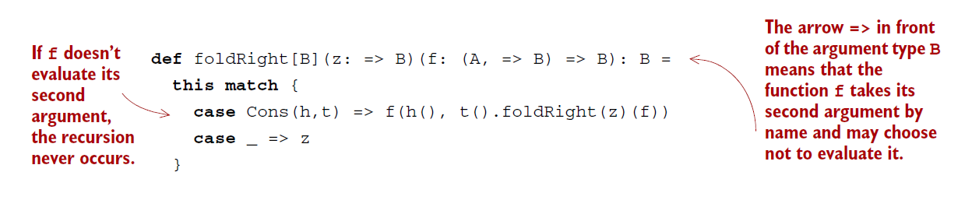
exists: Using General Recursion
foldRight to implement exists:
def exists(p: A => Boolean): Boolean = foldRight(false)((a, b) => p(a) || b)
Here b is the unevaluated recursive step that folds the tail of the stream. If p(a) returns true, b will never be evaluated and the computation terminates early.
Notes:
Since foldRight can terminate the traversal early, we can reuse it to implement
exists. We can’t do that with a strict version of foldRight. We’d have to write a specialized
recursive exists function to handle early termination. Laziness makes our
code more reusable.

Slide 24
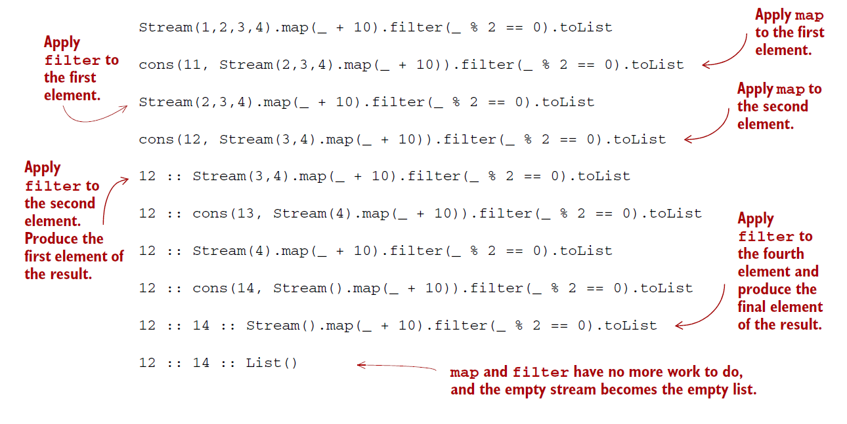
Program trace for Stream: Re-Visited
Notes:
Filter and map transformations are interleaved—the computation alternates between generating a single element of the output of map, and testing with filter to see if that element is divisible by 2 (adding it to the output list if it is). Note that we don’t fully instantiate the intermediate stream that results from the map. It’s exactly as if we had interleaved the logic using a special purpose loop. For this reason, people sometimes describe streams as “first-class loops” whose logic can be combined using higher-order functions like map and filter.

Slide 25
Explanation
Filter and map transformations are interleaved—the computation alternates between generating a single element of the output of map, and testing with filter to see if that element is divisible by 2 (adding it to the output list if it is).
Note: We don’t fully instantiate the intermediate stream that results from the map.
It’s exactly as if we had interleaved the logic using a special purpose loop.
For this reason, people sometimes describe streams as “first-class loops” whose logic can be combined using higher-order functions like map and filter.

Slide 26
Benefits: Memory Usage.
As Intermediate streams aren’t generated, a transformation of the stream requires only enough working memory to store and transform the current element.
Example: Stream(1,2,3,4).map(_ + 10).filter(_ % 2 == 0)
The garbage collector can reclaim the space allocated for the values 11 and 13 emitted by map as soon as filter determines they aren’t needed.
Thus, for larger numbers of elements, Being able to reclaim this memory as quickly as possible can cut down on the amount of memory required by your program as a whole.

Slide 27
Infinite Streams and Corecursion
Example: An Infinite Stream of 1’s
val ones: Stream[Int] = Stream.cons(1, ones)
But our functions work on infinite streams too.
scala> ones.take(5).toList res0: List[Int] = List(1, 1, 1, 1, 1) scala> ones.exists(_ % 2 != 0) res1: Boolean = true
WARNING: Be Careful while using them with infinite streams since it’s easy to write expressions that never terminate or aren’t stack-safe. Ex: ones.forAll(_ == 1)

Slide 28
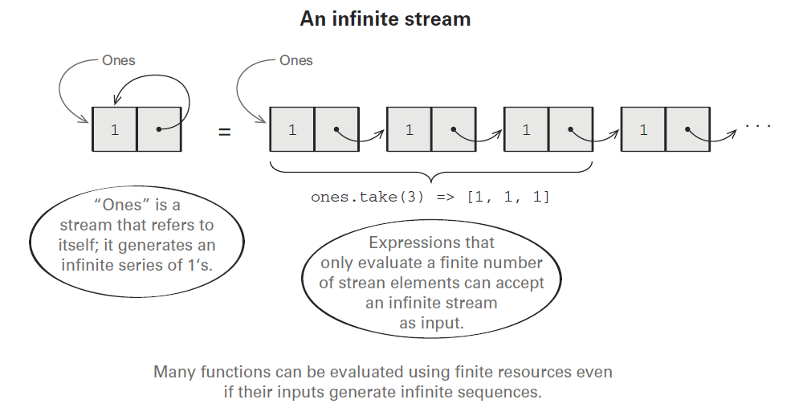
An Infinite Stream of 1’s

Slide 29
unfold: A ‘more’ general stream building function
def unfold[A, S](z: S)(f: S => Option[(A, S)]): Stream[A]
It takes an initial state, and a function for producing both the next state and the next value in the generated stream.
Option is used to indicate when the Stream should be terminated if at all.
The unfold function is an example of a corecursive function.
unfold is productive as long as f terminates, since we just need to run the function f one more time to generate the next element of the Stream

Slide 30
Recursive vs. Co-Recursive Function
Whereas a recursive function consumes data, a corecursive function produces data.
And whereas recursive functions terminate by recursing on smaller inputs, corecursive functions need not terminate so long as they remain productive, which just means that we can always evaluate more of the result in a finite amount of time.
Corecursion sometimes called guarded recursion, and
Productivity sometimes called cotermination.

Slide 31
Implement hasSubsequence using Laziness
def hasSubsequence[A](s: Stream[A]): Boolean =
tails exists (_ startsWith s)
This implementation performs the same number of steps as a more monolithic implementation using nested loops with logic for breaking out of each loop early.
By using laziness, we can compose this function from simpler components and still retain the efficiency of the more specialized (and verbose) implementation.
Note: tails returns the Stream of suffixes of the input sequence, starting with the original Stream ; startsWith check if one Stream is a prefix of another.

Slide 32
Conclusion
Introduced non-strictness as a fundamental technique for implementing efficient and modular functional programs.
A bigger idea—non-strictness can improve modularity by separating the description of an expression from the how-and-when of its evaluation.
Keeping these concerns separate lets us reuse a description in multiple contexts, evaluating different portions of our expression to obtain different results.
NEXT CHAPTER: Purely functional approaches to state.

Slide 33
THANK YOU!

